Slide 1


7. DASHing Apps
Mrinal Vashisth
PhD Year 2, Computational Psychometrics, TSU, RF
M.Sc. Human Development: Genetics, Neuroscience and Psychology, TSU, RF
M.S. Applied Mathematics and Information Technology (Systems Biology and Bioinformatics), ITMO, RF
B.Tech. Biotechnology, JNU, RI

Slide 2
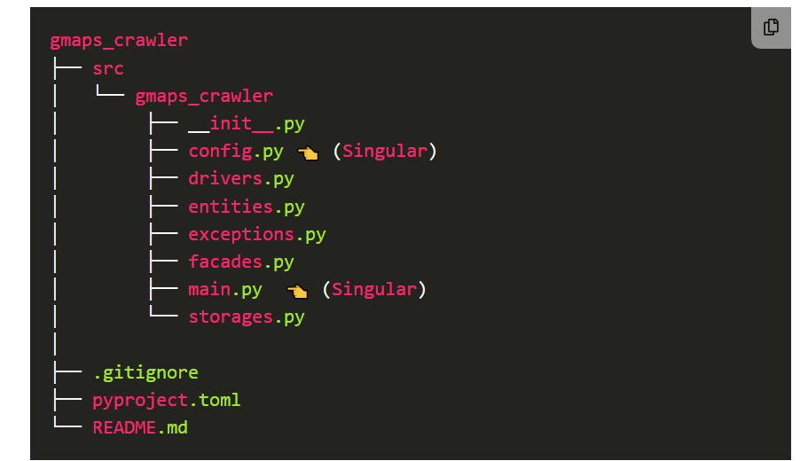
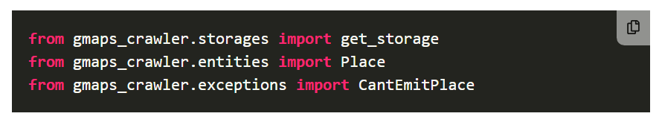
Code organization and practices
Recommended reading
https://guicommits.com/organize-python-code-like-a-pro/

Slide 3
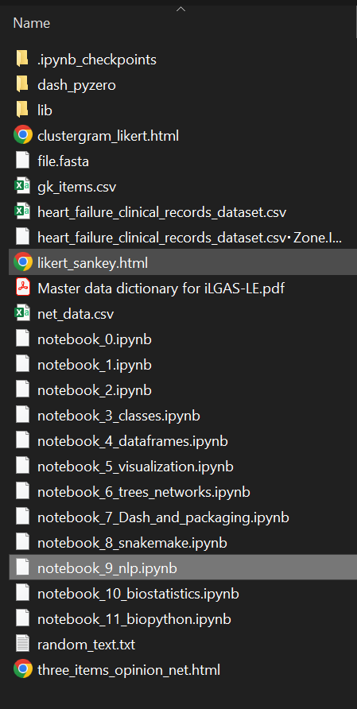
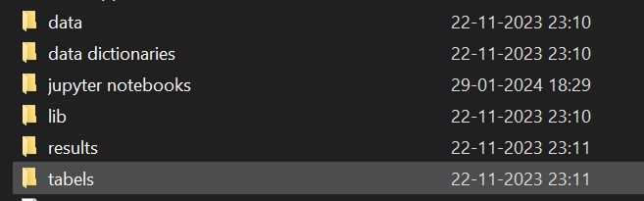
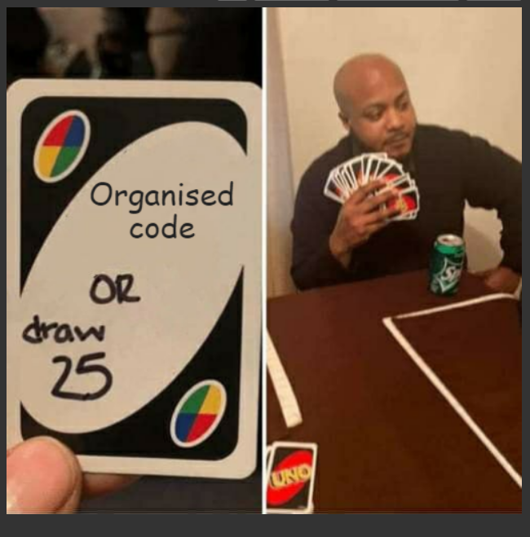
Thesis code organization
Code organization for this class

Slide 4
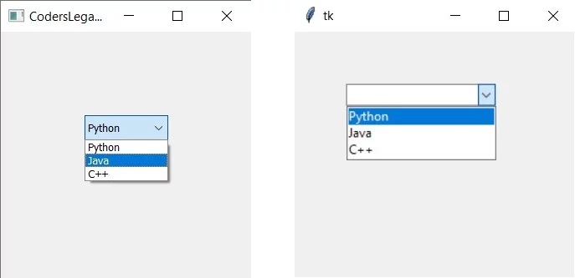
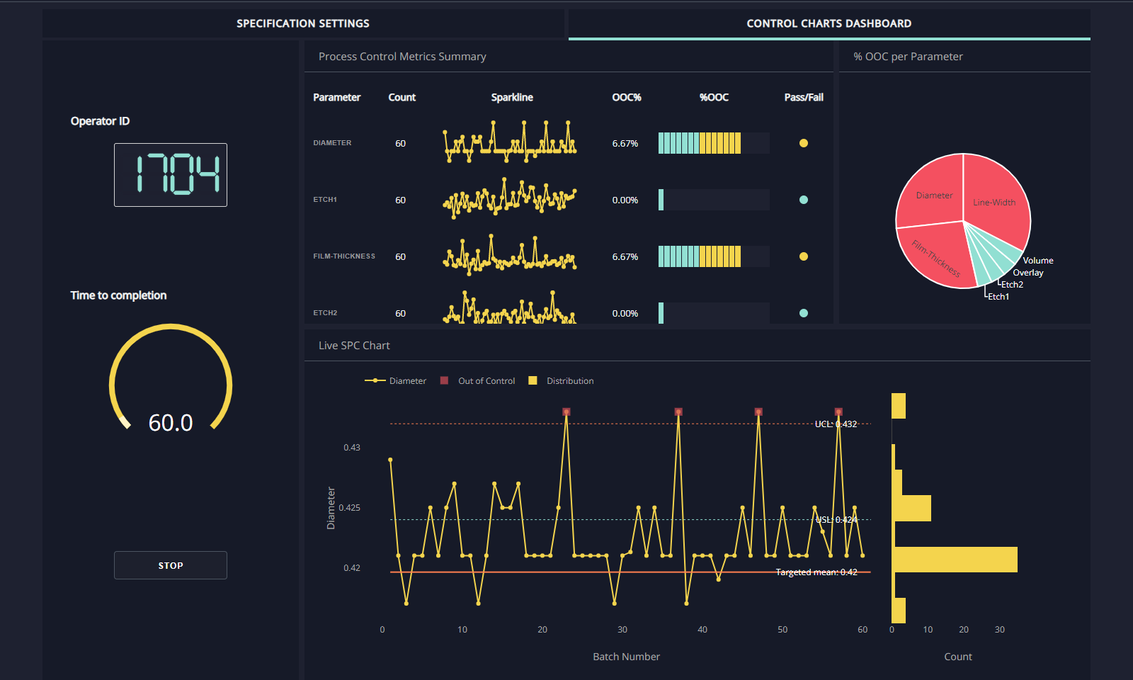
Notebooks versus IDE
https://www.reddit.com/r/learnpython/comments/wirpqi/pycharm_vs_jupyter_notebook/
Notebooks are aimed at visualization
We will take an example of dash app, that can be done using either notebooks or IDEs
IDE is the first solution for developing software/ software design
DASH apps is good for data exploratory and visualization apps
QT, Tinkter and so on, help you to design GUI apps

Slide 5
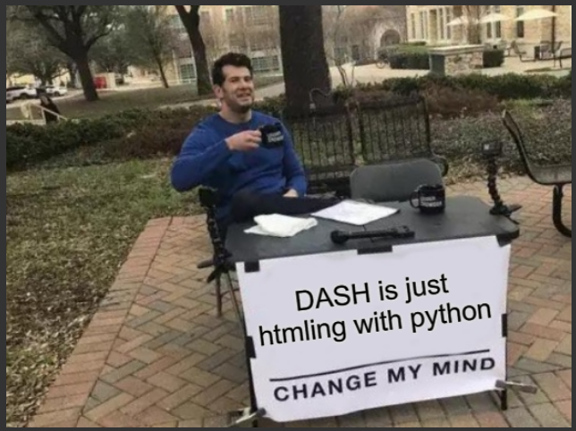
Introduction to DASH apps
https://dash.plotly.com/
Recommended tutorial, if this direction is selected: https://www.youtube.com/watch?v=Ma8tS4p27JI&list=PLH6mU1kedUy8fCzkTTJlwsf2EnV_UvOV-
Recommended tutorial, if you want to learn about software architecture and create a modular (modules) structure to your program: https://www.youtube.com/watch?v=-njsRb8Tn70&t=636s

Slide 6
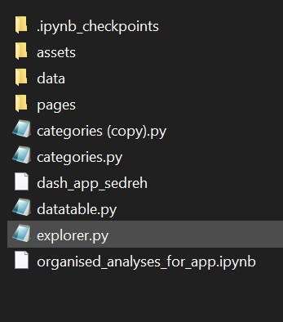
Recipe for a DASHing app
assets, data and separate pages of the app goes in these directories
literally, the entire app

Slide 7
Practical: Jupyter notebook 7

Slide 8
8. Snakemake
Mrinal Vashisth
PhD Year 2, Computational Psychometrics, TSU, RF
M.Sc. Human Development: Genetics, Neuroscience and Psychology, TSU, RF
M.S. Applied Mathematics and Information Technology (Systems Biology and Bioinformatics), ITMO, RF
B.Tech. Biotechnology, JNU, RI

Slide 9
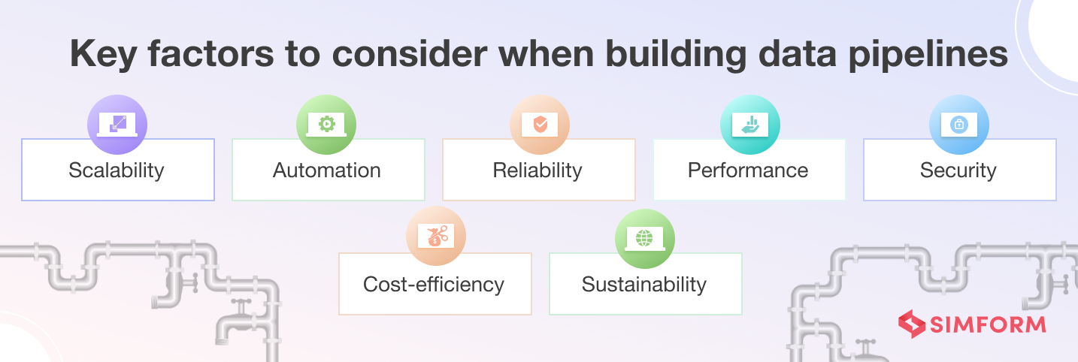
Why pipeline?
Read pipelining.pdf
https://www.simform.com/blog/best-practices-to-build-data-pipelines/

Slide 10
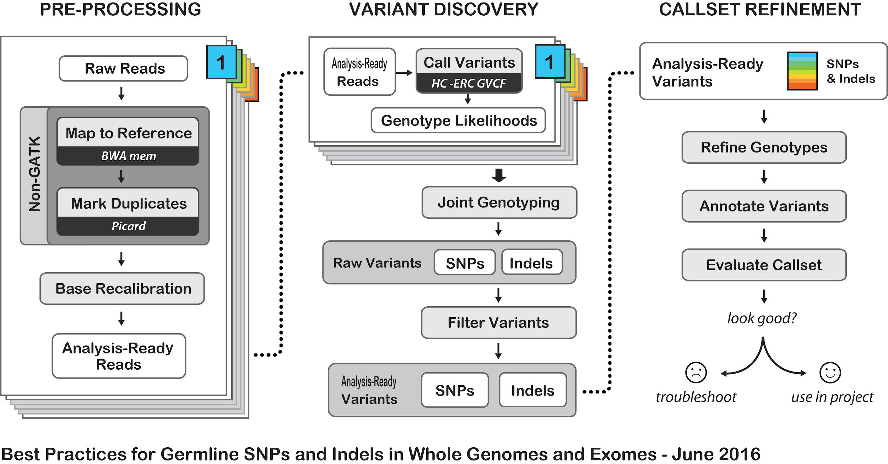
Example - GATK4

Slide 11
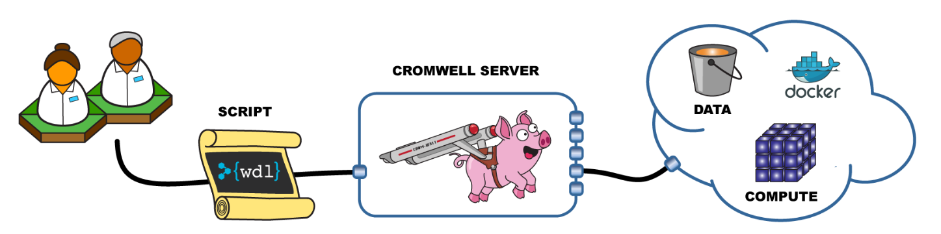

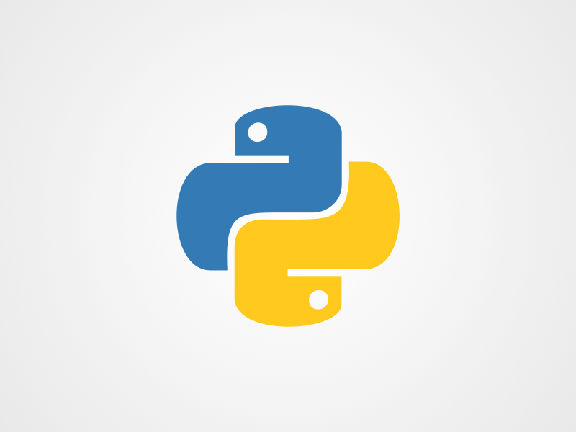
Snakemake
Snakemake has a pure python syntax, we can combine rules and functions together to create a more robust and reproducible analysis.

Slide 12
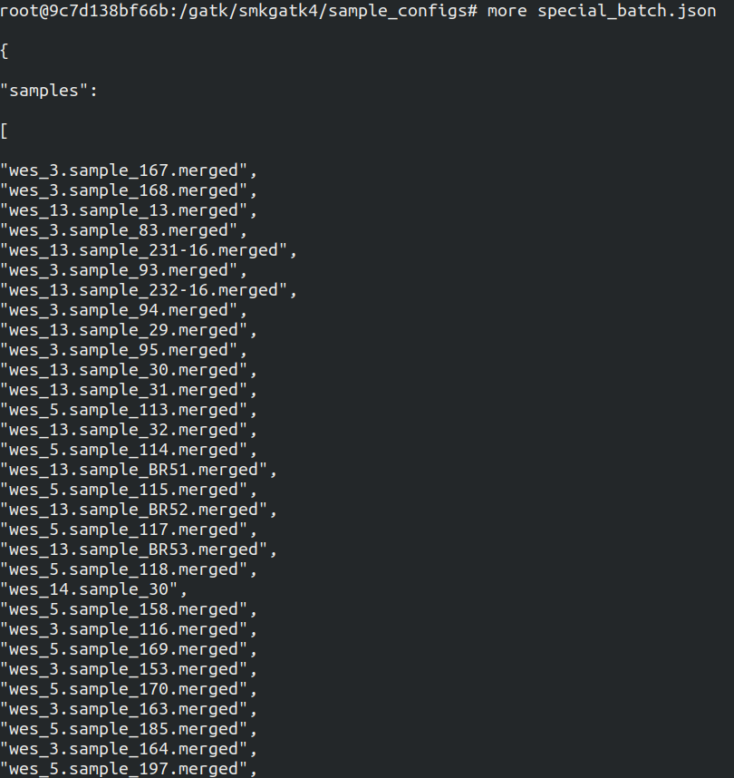
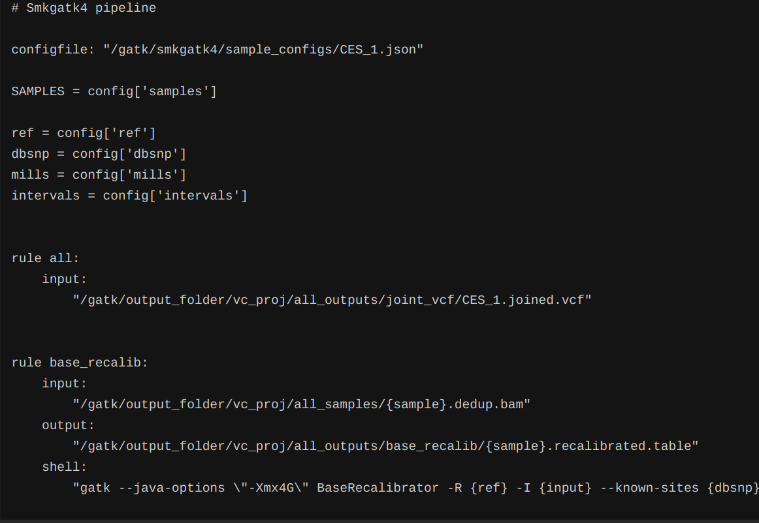
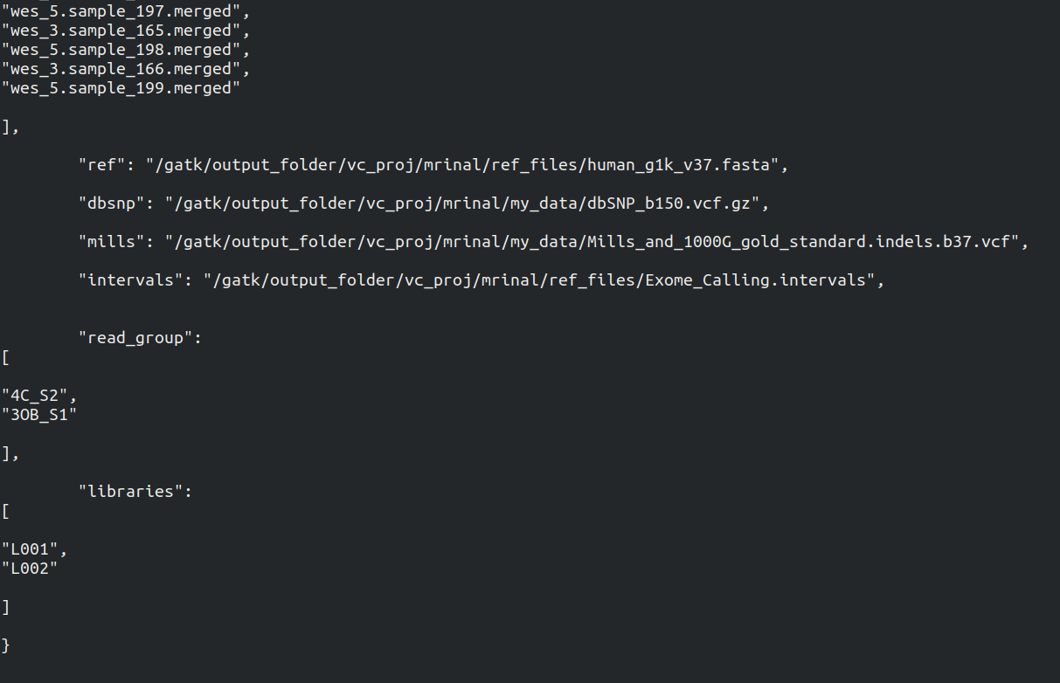

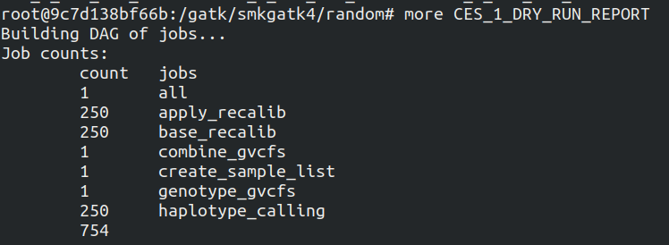
Config
Contains sample information
Snakefile
Containing rules for execution

Slide 13
Go to Jupyter notebook 8.

